Slide 1
Design and Analysis of Algorithms
Unit IV : Greedy Method

Slide 2
Greedy Approach
The greedy approach suggests constructing a solution through a sequence of steps, each expanding a partially constructed solution obtained so far, until a complete solution to the problem is reached.
At each step the choice made to expand partially constructed solution must be:
feasible, i.e., it has to satisfy the problem’s constraints
locally optimal, i.e., it has to be the best local choice among all feasible choices available on that step
irrevocable, i.e., once made, it cannot be changed on subsequent steps of the algorithm

Slide 3
Finding a Minimum Spanning Tree
A spanning tree of an undirected connected graph is its connected acyclic sub graph (i.e., a tree) that contains all the vertices of the graph.
If such a graph has weights assigned to its edges:
A minimum spanning tree is its spanning tree of the smallest weight, where the weight of a tree is defined as the sum of the weights on all its edges.
The minimum spanning tree problem is the problem of finding a minimum spanning tree for a given weighted connected graph

Slide 4
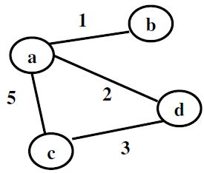
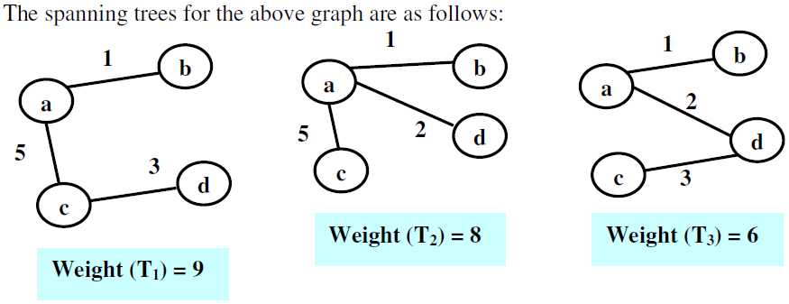

Slide 5
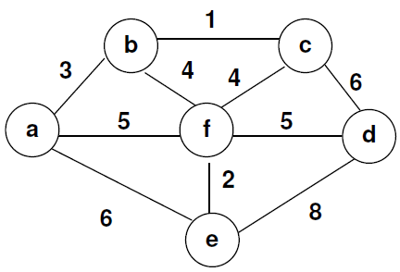
Find Minimum Spanning Tree of the following graph.

Slide 6
Prims Algorithm
Prim’s algorithm constructs a minimum spanning tree through a sequence of expanding subtrees.
The initial subtree in such a sequence consists of a single vertex selected arbitrarily from the set V of the graph’s vertices
On each iteration, the algorithm expands the current tree in the greedy manner by simply attaching to it the nearest vertex not in that tree.
The algorithm stops after all the graph’s vertices have been included in the tree being constructed. Since the algorithm expands a tree by exactly one vertex on each of its iterations, the total number of such iterations is n − 1, where n is the number of vertices in the graph.

Slide 7
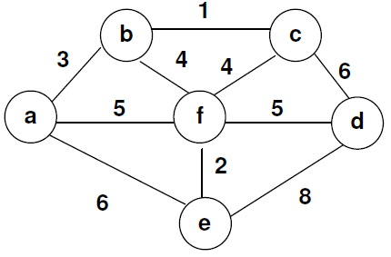
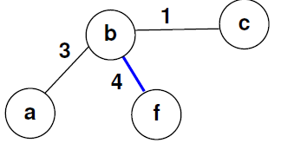
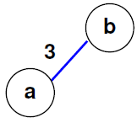
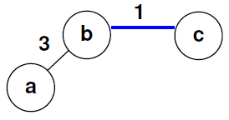
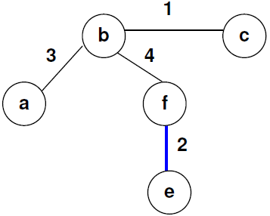
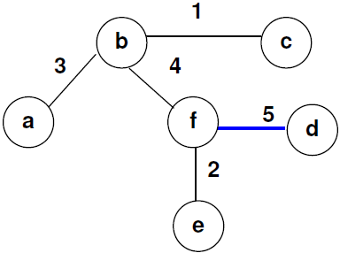
Prim’s Algorithm:

Slide 8
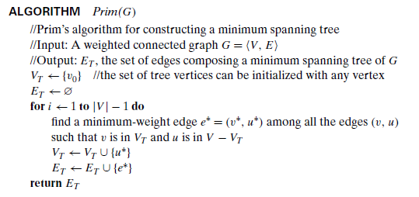
Pseudo Code of Prims Algorithm

Slide 9
Implementation of Prims Algorithm
Each vertex not in the current tree should have the information of its nearest tree vertex and the distance to that vertex
This is provided by attaching two labels to a vertex: the name of the nearest tree vertex and the length (the weight) of the corresponding edge.
Vertices that are not adjacent to any of the tree vertices can be given the ∞ label indicating their “infinite” distance to the tree vertices and a null label for the name of the nearest tree vertex.
We can split the vertices that are not in the tree into two sets, the “fringe” and the “unseen.” The fringe contains only the vertices that are not in the tree but are adjacent to at least one tree vertex.
The fringe vertices are the candidates from which the next tree vertex is selected.
The unseen vertices are all the other vertices of the graph, called “unseen” because they are yet to be affected by the algorithm.
Finding the next vertex U* to be added to the current tree T =<V_{T}, E_{T} > becomes a simple task of finding a vertex with the smallest distance label in the set V − V_{T} .

Slide 10
Implementation of Prims Algorithm
After a vertex u∗ to be added to the tree is identified, we need to perform two operations
Move u∗ from the set V − V_{T} to the set of tree vertices V_{T} .
For each remaining vertex u in V − V_{T} that is connected to u∗ ,
if the u’s distance label is greater than the distance between u and u* (d_{u} > w[u*,u])
update labels of u
1) by u∗ and
2) the weight of the edge between u* and u, respectively.

Slide 11
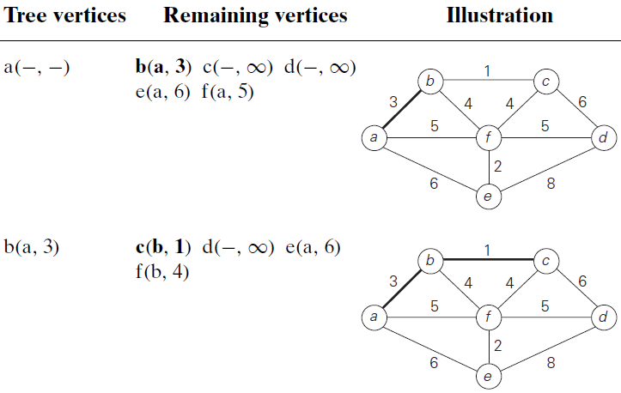
Prim’s Algorithm:

Slide 12
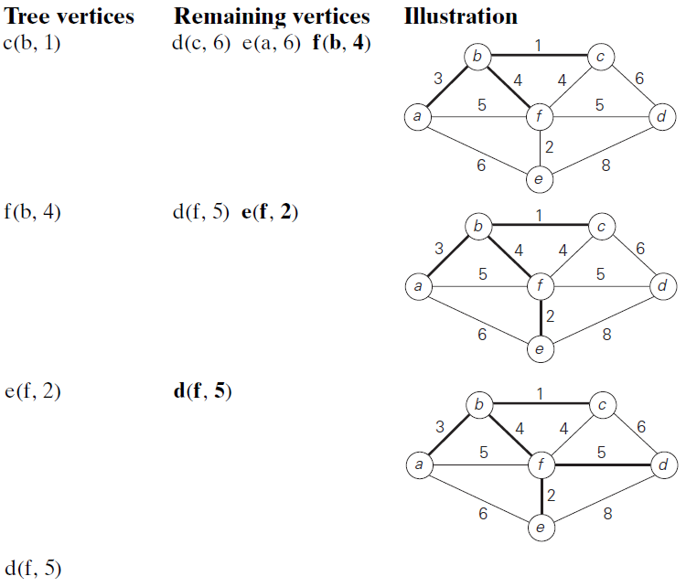

Slide 13
Efficiency of Prims Agorithm
The Efficiency depends on the data structures chosen for the graph itself and for the priority queue of the set V − V_{T} whose vertex priorities are the distances to the nearest tree vertices.
if a graph is represented by its weight matrix and the priority queue is implemented as an unordered array, the algorithm’s running time will be in (|V |²).
We can also implement the priority queue as a min-heap
Deletion of the smallest element from and insertion of a new element into a min-heap of size n are O(log n)operations, and so is the operation of changing an element’s priority.
If a graph is represented by its adjacency lists and the priority queue is implemented as a min-heap, the running time of the algorithm is in O(|E| log |V |). This is because the algorithm performs |V| − 1 deletions of the smallest element and makes |E| verifications and, possibly, changes of an element’s priority in a min-heap of size not exceeding |V |. Each of these operations, is a O(log |V |) operation. Hence, the running time of this implementation of Prim’s algorithm is in (|V| − 1+ |E|)O(log |V |) = O(|E| log |V |)
.

Slide 14
Kruskal’s Algorithm.
Named after Joseph Kruskal, who discovered this algorithm.
Kruskal’s algorithm looks at a minimum spanning tree of a weighted connected graph G = V, E as an acyclic sub graph with |V| − 1 edges for which the sum of the edge weights is the smallest.
The algorithm begins by sorting the graph’s edges in non decreasing order of their weights. Then, starting with the empty sub graph, it scans this sorted list, adding the next edge on the list to the current sub graph if such an inclusion does not create a cycle and simply skipping the edge otherwise

Slide 15
Example.

Slide 16
Example.

Slide 17
Kruskal’s algorithm has to check whether the addition of the next edge to the edges already selected would create a cycle.
A new cycle is created if and only if the new edge connects two vertices already connected by a path, i.e., if and only if the two vertices belong to the same connected component
Note also that each connected component of a sub graph generated by Kruskal’s algorithm is a tree because it has no cycles.
We can consider the algorithm’s operations as a progression through a series of forests containing all the vertices of a given graph and some of its edges.
The initial forest consists of |V | trivial trees, each comprising a single vertex of the graph. The final forest consists of a single tree, which is a minimum spanning tree of the graph.
On each iteration, the algorithm takes the next edge (u, v) from the sorted list of the graph’s edges, finds the trees containing the vertices u and v, and, if these trees are not the same, unites them in a larger tree by adding the edge (u, v).

Slide 18
Union Find Algorithms : Algorithms to check for whether two vertices belong to the same tree
With an efficient union-find algorithm, the running time of Kruskal’s algorithm will be dominated by the time needed for sorting the edge weights of a given graph. Hence, with an efficient sorting algorithm, the time efficiency of Kruskal’s algorithm will be in O(|E| log |E|).

Slide 19
Dijkstras Algorithm : single-source shortest-paths problem
For a given vertex called the source in a weighted connected graph, find shortest paths to all its other vertices.
Dijkstra’s algorithm is applicable to undirected and directed graphs with nonnegative weights only.

Slide 20
Implementation
Dijkstra’s algorithm finds the shortest paths to a graph’s vertices in order of their distance from a given source. First, it finds the shortest path from the source to a vertex nearest to it, then to a second nearest, and so on.
In general, before its i^{th} iteration commences, the algorithm has already identified the shortest paths to i − 1 other vertices nearest to the source.
These i vertices ( the source, and the edges of the shortest paths leading to them from the source ) form a sub tree T_{i} of the given graph,
The set of vertices adjacent to the vertices in Ti can be referred to as “fringe vertices”; they are the candidates from which algorithm selects the next vertex nearest to the source.

Slide 21
Implementation
To identify the i^{th} nearest vertex, the algorithm computes
for every fringe vertex u,
the distance to the nearest tree vertex v +
the length of the shortest path from v to the source
then selects the vertex with the smallest such sum.

Slide 22
Implementation
To implement this, each vertex is labelled with two labels.
The numeric label d indicates the length of the shortest path from the source to this vertex found so far.
The other label indicates the name of the preceding vertex on such a path
With such labeling, finding the next nearest vertex u∗ becomes a simple task of finding a fringe vertex with the smallest d value.

Slide 23
After we have identified a vertex u∗ to be added to the tree, two operations are performed.
Move u* from fringe to set of tree vertices
For each of the remaining vertex u that is connected to u* by an edge weight w(u*,u)
if d_{u} > d_{u*} + w(u*,u)
update the labels of u by
1. u* and
2. d_{u*} + w(u*,u)

Slide 24
Pseudo Code.

Slide 25
Example.

Slide 26
Example.

Slide 27
Huffman Trees. Some Terminologies
If we have to encode a text that comprising symbols from some n-symbol alphabet by assigning to each of the text’s symbols some sequence of bits called the codeword. – There are two options
fixed-length encoding : assigns to each symbol a bit string of the same length m (m ≥ log₂n). This is exactly what the standard ASCII code does.
Variable-length encoding : is based on the old idea of assigning shorter codewords to more frequent symbols and longer codewords to less frequent symbols. This idea was used, in particular, in the telegraph code invented in the mid-19th century by Samuel Morse. This yields shorter bit string on the average.
prefix-free (or simply prefix) codes : In a prefix code, no codeword
is a prefix of a codeword of another symbol.

Slide 28
Huffman’s algorithm. Greedy algorithm, invented by David Huffman while he was a graduate student at MIT. Used to Create a Prefix code.
Given alphabet with known frequencies of the symbol occurrences, the Algorithm constructs a tree that would assign shorter bit strings to high-frequency symbols and longer ones to low-frequency symbols.
Step 1 Initialize n one-node trees and label them with the symbols of the alphabet given. Record the frequency of each symbol in its tree’s root to indicate the tree’s weight.
Step 2 Repeat the following operation until a single tree is obtained. Find two trees with the smallest weight. Make them the left and right subtree of a new tree and record the sum of their weights in the root of the new tree as its weight.
A tree constructed by the above algorithm is called a Huffman tree. It
defines—in the manner described above—a Huffman code

Slide 29

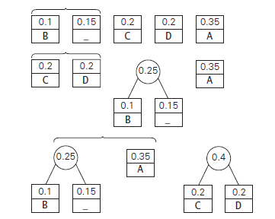
EXAMPLE Consider the five-symbol alphabet {A, B, C, D, _ } with the following occurrence frequencies in a text made up of these symbols
The Huffman tree construction for this input

Slide 30
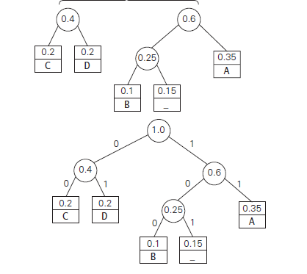

Slide 31
DAD is encoded as 011101, and 10011011011101 is decoded as BAD_AD.
With the occurrence frequencies given and the codeword lengths obtained,
the average number of bits per symbol in this code is
2 * 0.35 + 3 * 0.1+ 2 * 0.2 + 2 *0.2 + 3 * 0.15 = 2.25.
Had we used a fixed-length encoding for the same alphabet, we would have to use at least 3 bits per each symbol. Thus, for this example, Huffman’s code achieves the compression ratio—a standard measure of a compression algorithm’s effectiveness—of
0.75/3 *100 = 25%
Huffman’s encoding of the text will use 25% less memory than its fixed-length encoding

